Slide 1

Basics of Neural Network Programming
Logistic Regression
deeplearning.ai

Slide 2
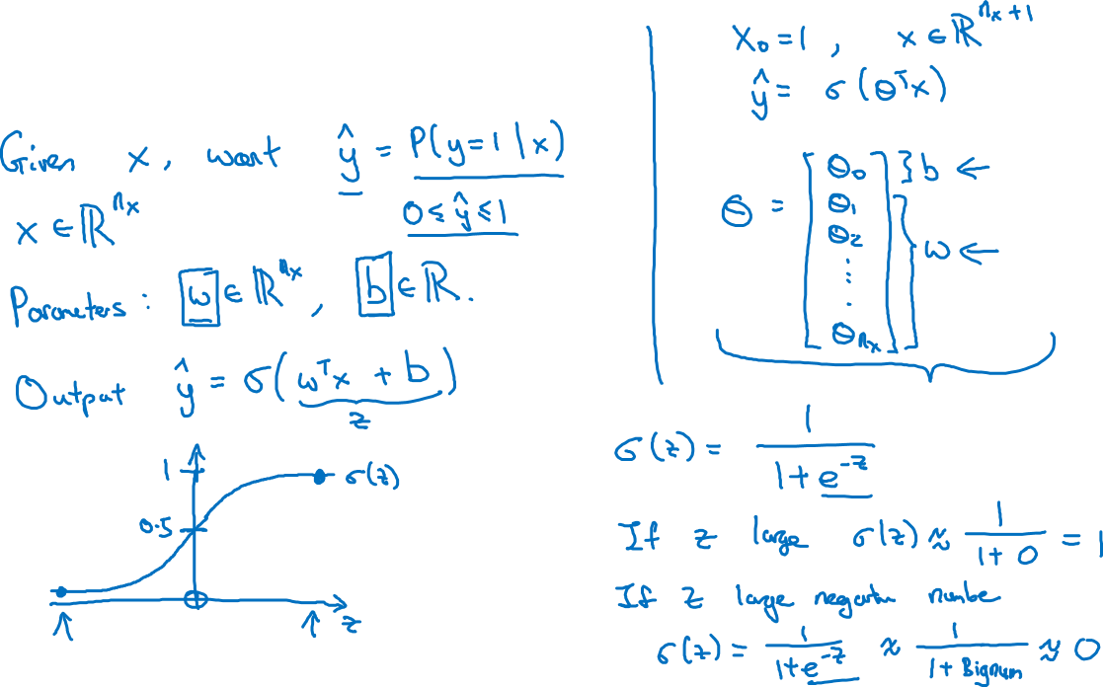
Logistic Regression
Notes:
Learning algorithm for binary classification problems.
Y^ = More formally, you want Y hat to be the probability of the chance that,
Y is equal to one given the input features X.
For example, lets say if x is a picture, we want to predict what is the chance that this is a cat picture.
In linear regression we do prediction by using weight, bias & data values as a linear function to predict, however here we are looking for a chance rather than actual value.
& we want the prediction to be probabilistic.
Y hat should be between 0 & 1 where as Wx+b can be bigger than 1 & less than 0 as well.
Therefore we apply sigmoid function, sigmoid converts the function between 0 & 1.
This function will turn very large values to 1 and very small values to 0.
For bias term , we are keeping it separate, where as in some notation it is considered as a feature as shown. It turns out, if we keep w & b as separate parameter.
In this class, we will keep them separate.
What are the parameters of logistic regression?
W, an nx​ dimensional vector, and b, a real number.

Slide 3
Basics of Neural Network Programming
Logistic Regression
cost function
deeplearning.ai

Slide 4
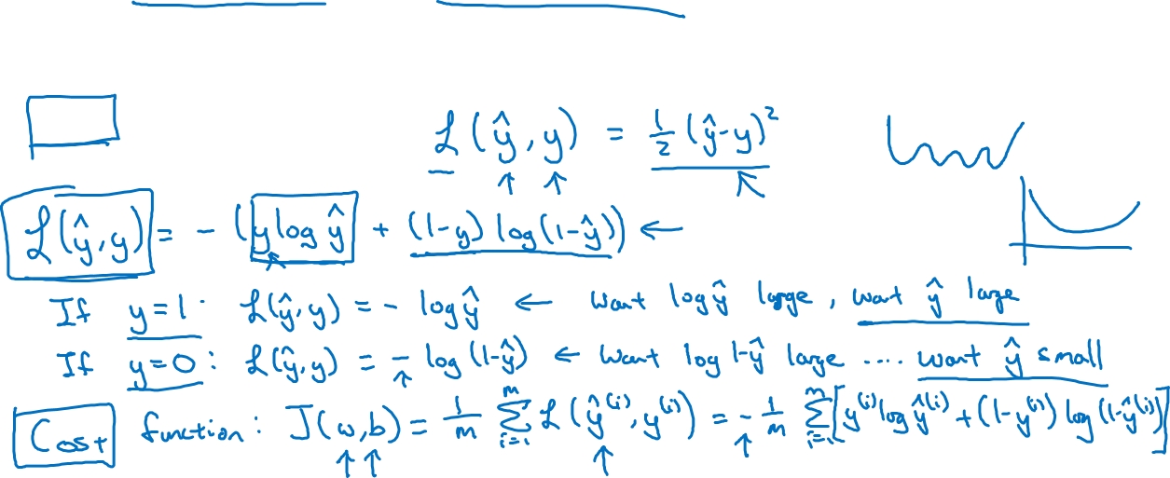
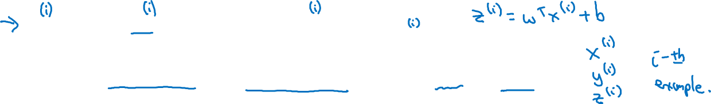
Logistic Regression cost function
$\hat{y} = σ\left(w^{T}x +b\right)$, where $σ\left(z \right)=\frac{1}{1+e^{−z}}$
Given $\left\{{(x}^{(1)},y^{(1)}\text{)}\text{,}\text{…}\text{,}{(x}^{(m)},y^{(m)}\text{)}\right\},$want ${\hat{y}}^{(i)}≈y^{\left(i\right)}$.
Loss (error) function:

